Slide 1
Predicting
the Growth Rate of
YouTube Videos
STATS 101C LEC 4 Final Competition
Team: MLA - Ashlyn Jew, Haozhen Ni, Huimin Zhang

Slide 2
Introduction
YouTube is a large global video-sharing platform
Views are one of the most important metrics of a video
We aim to predict the percentage change in views on a video between the second and sixth hour since its publishing
This will help the content creator determine the eventual performance of their video and the overall success of their channel
Notes:
YouTube is a large global video-sharing platform where users can interact with videos in various ways.
Views are one of the most important metrics of a video, knowing how fast a video’s number of views grow in the first few hours after it has been uploaded is a useful indicator for content creators.
In this project, we aim to predict the percentage change in views on a video between the second and sixth hour since its publishing.
This will help the content creator determine the eventual performance of their video and the overall success of their channel.

Slide 3
Understanding Our Data
There are 260 variables and 7242 observations in our data set
Each observation corresponds to a YouTube video and each variable to a feature of the video
Notes:
Features fall into 4 categories:
Thumbnail image features (e.g. colors in the thumbnail)
Video title features (e.g. number of words)
Channel features (e.g. number of subscribers)
Other features (e.g. video duration)

Slide 4
Methodology - Data Preprocessing
We split the “PublishedDate” variable into separate month, day, hour, and minute variables
We deleted columns that contained only 0 values
We excluded quantitative variables that are highly correlated
We end up with 179 variables
Notes:
we believe that the date and time a video is published influences the number of early views. For example, if a video is published at midnight (in the timezone of the channel’s largest audience), then there would not be many views between the second and sixth hour because most people are sleeping during that period.
They have no effect on the model
Correlated predictors can affect the accuracy of the model(?

Slide 5
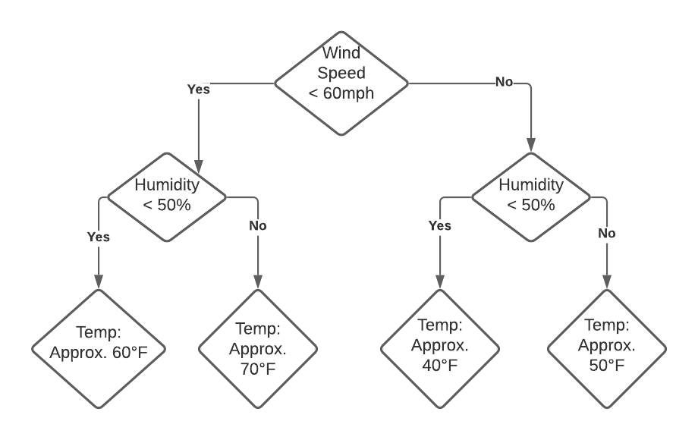
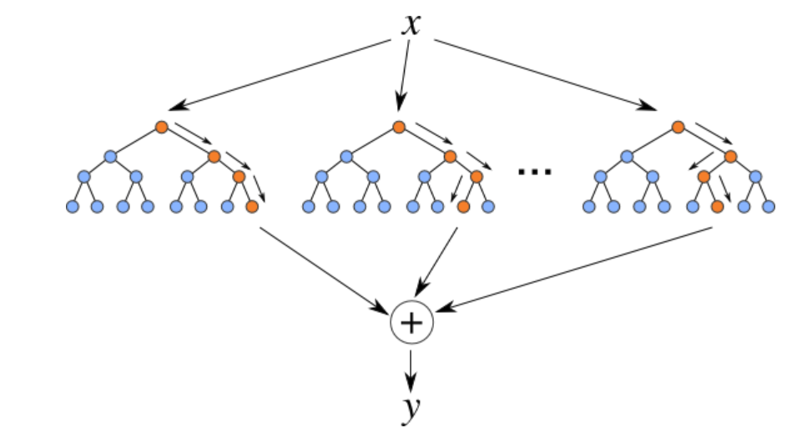
Methodology - Statistical Model
We chose to use a tree-based model called bagged regression model
Handles data with many variables
Powerful prediction tool
Basic idea of our model
Decision Trees → Random Forest
Notes:
Our model is composed of many decision trees.
Decision trees work like If-Then-Else statements.
Let’s say you want to estimate today’s air temperature. You think wind speed and humidity are factors that affect the temperature. So you would follow this decision tree to get an approximation of the temperature. For example, you know the wind speed is less than 60 mph, so you go left. You see that humidity is greater than 50%, so you go right, and now you can approximate that the temperature is 70 degrees F.
And to get a random forest, you basically combine a bunch of decision trees to help you predict the temperature. Our model for predicting the growth rate of YouTube videos work similarly.
Figure 2 source: https://levelup.gitconnected.com/random-forest-regression-209c0f354c84

Slide 6
Methodology - Statistical Model
We used a technique called bagging to reduce the variance of our model and improve accuracy
We used 5-fold cross-validation for feature selection
Cross-validation is a method used to estimate how the model is expected to perform with different number of variables
Model with 22 to 45 variables would work best
We chose the top 25 most important variables
Notes:
We then built another bagged regression model with these variables.

Slide 7
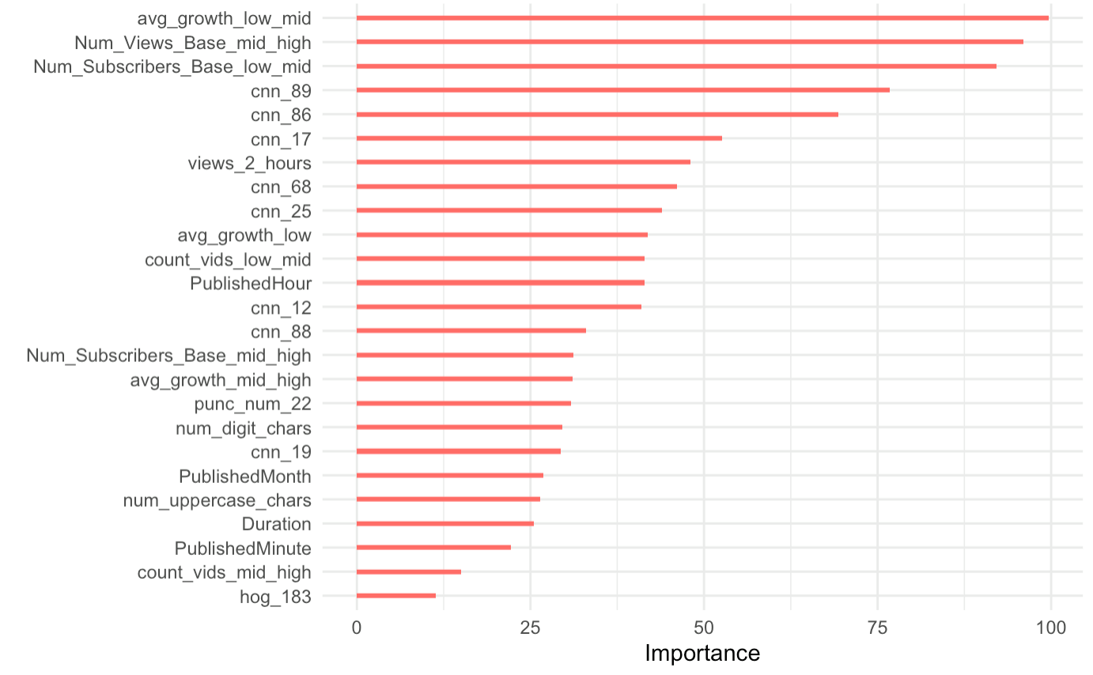
Top 25 Most Important Variables
Notes:
We see that the published date and time are among the top 25 most important variables as we have mentioned previously.

Slide 8
Conclusion
Reasons our model works well:
Choice of bagged regression model
Reducing the number of predictors to the most important variables
Model with 25 variables performed best on the public leaderboard
RMSE of 1.38825
Model with 40 variables performed best on the private leaderboard
RMSE of 1.38810
25-variable model may have excluded some variables important to the overall data
Notes:
The model with 25 variables performed best on the PUBLIC leaderboard but the model with 40 variables performed best on the PRIVATE leaderboard. This may be because the 25-variable model may have excluded some variables important to the overall data.

Slide 9
Conclusion
We can improve our model by finding the optimal number of predictors to include in our model
Suggestion for YouTubers:
Know the timezone of your main audience
Upload during active hours
Notes:
Suggestion for YouTubers: Know the timezone of your main target audience, and take note of the date and time that your audience is active and upload during those hours.

Slide 10
Thank You!

